Slide 1

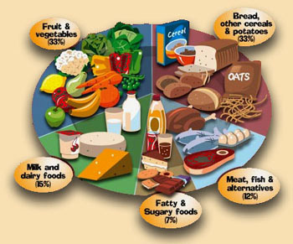
(Introduction to Environmental Studies)
B. Tech 3rd Semester
Food Resources
Unit 2
Natural Resources
Department: Chemistry
Subject: Environmental Studies (CHM2041)

Slide 2
Contents
Introduction to Food
Food Resources
World Food Problems
Balanced diet
Impacts of overgrazing on agriculture
Modern Agriculture and its impacts
Notes:
2

Slide 3
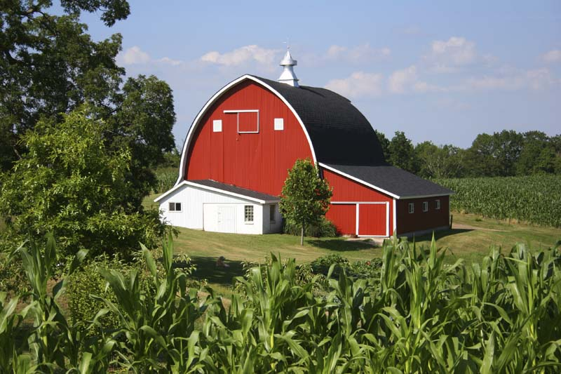
Food
Materials, usually of plant or animal origin, that contain essential body nutrients.
Food is the basic material which the body need for its survival and well being.
Good food is indispensable for health at all stages of life and for proper growth during infancy, childhood, adolescence and adulthood.
Man eats a variety of foods of plant and animal origin
No single food provides us with all the nutrients that we need.

Slide 4
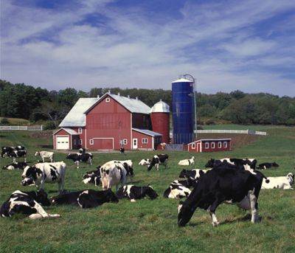
Food resources
Resources that are used as food, or provide food for organisms are called food resources.
Sources of food:
We obtain food from mainly two types of natural sources :
Plants
Animals
Microorganism

Slide 5
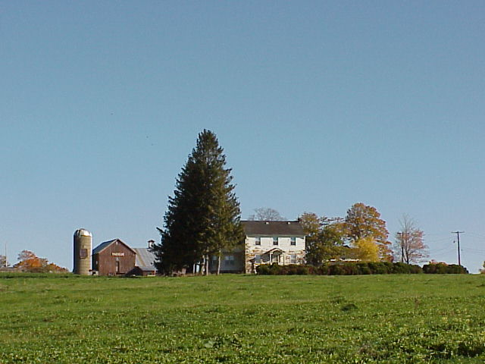
Plants as food sources
Plants serve as food resources for herbivores and omnivores.
In India, the main source of food is agriculture.
Main kinds of agricultural products :
  Cereals
  Pulses
  Spices
  Beverages
  Vegetables
  Fruits

Slide 6
Plants as food sources
2,50,000 of plant identified
3,000 species tried as agricultural crop
300 species are grown for food
100 species used on a large scale
20 crops is provides world 60 % of calories requirement

Slide 7
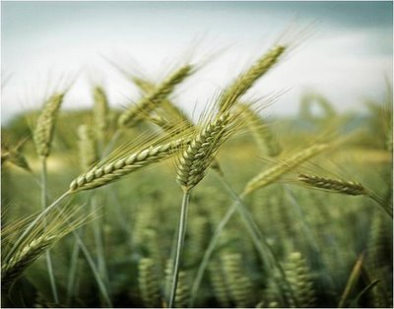
Plants as food sources
Cereals: They are grasses in nature which are cultivated for their edible grains.
Provide more food energy than any other crop.
Pulses: Pulses are edible seeds of leguminous plants.
important food crops due to their nutritional/protein value.
Examples : Grams, Peas, Dal, etc.
Spices: A spice is a dried vegetative substance used as a food additive for flavour, colour, or as a preservative.
India is one of the greatest spice producers & consumer of the world.
Examples : Cumin, cardamom, cinnamon, etc.
Beverages: Beverages are drinks meant for human consumption. They are also cultivated as crops.
Examples : Tea, coffee, etc.

Slide 8
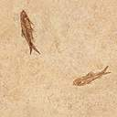
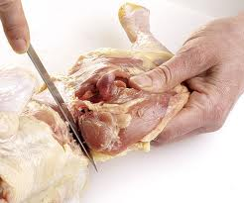
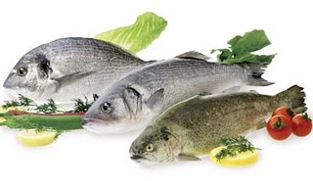
Animals & birds as food resources
Animals and birds are a huge source of food for many organisms who are carnivores and omnivores.
They are of the following origin :
Animal meat:(Sheep, Goats,Rabbit ,Deer)
Bird Meat: Chicken,
Aquatic
(Fish and sea food contribute about 70 MMT of high quality protein to the world’s diet.

Slide 9

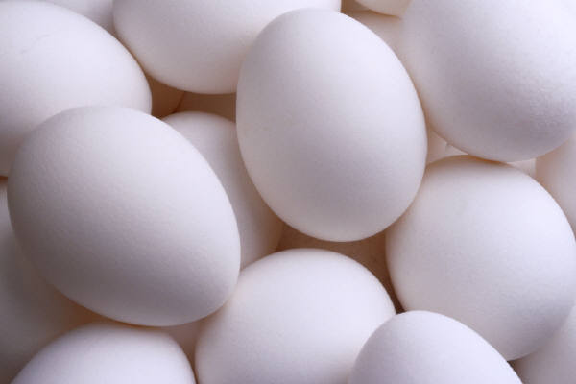
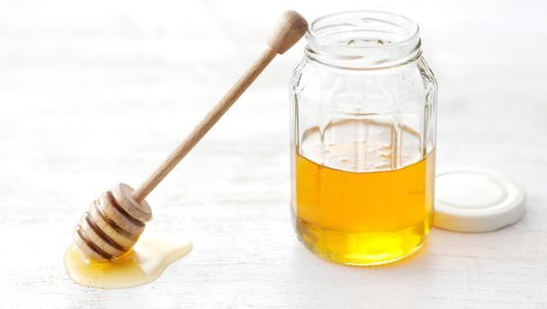
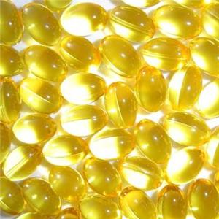
Eggs and other bird/animal products
Eggs: are bird products & are very nutritious and a very viable source of food.
Milk: is an animal product, food for the offspring. Very nutritious and widely accepted.
Honey: is the product of nectar collected by honey bees from flowers & very rich in nutrients.
Animals oils, that has nutritional value. For instance, cod liver oil from fishes.

Slide 10
World Food Problems
During the last 50 years world grain production has increased almost 03 times.
The per capita production is increased by about 50%.
At the same time population growth increased at such a rate in less developed countries.
Every 40 million people die of Undernourishment and Malnutrition.
Every year food scarcity is killing as many people the atomic bomb dropped on Hiroshima during World War II.
Thus need to increase our food production, and also to control population growth.
It is estimated that 300 millions are still undernourished.

Slide 11

Undernourishment
Undernourishment: occurs when the body does not consume enough food or enough calories to support its needs. As a result the body begins to breakdown its own stored fats and proteins.
MALNOURISHMENT: Malnourishment is the lack of the minimum amount of fluids, proteins, carbohydrates, lipids, vitamins, minerals and other nutrients essential for sound health and growth.
Faulty nutrition may result from poor diet, lack of appetite or abnormal absorption of nutrients from gastrointestinal tract.
HUNGER HOTSPOT: The countries or regions that face Food Emergencies are referred as Hunger Hotspots.

Slide 12
Balanced diet
A Balanced Diet includes a variety of foods from all 5 food groups. It should provide enough calories to ensure desirable weight and should include all the necessary daily nutrients
Fruit & vegetables 33%
Milk & dairy foods 15%
Grains & potatoes 33%
Meat, fish & alternatives 12%
Sugar & fats 7%

Slide 13

Impacts of overgrazing on agriculture
Overgrazing:
Overgrazing can limit livestock production. Over grazing occurs when too many animals graze for too long and exceed the carrying capacity of a grass land area.
Impact of overgrazing
Land degradation: Overgrazing removes the grass cover. The humus content of the soil is decreased and it leads to poor, dry, compacted soil.
Soil erosion: The soil roots are very good binders of soil. When the grasses are removed, the soil becomes loose and susceptible to the action of wind and water.
Loss of useful species: Due to overgrazing the nutritious species like cenchrus, panicum etc. are replaced by thorny plants like Parthenium, Xanthium etc. These species do not have a good capacity of binding the soil particles and, therefore, the soil becomes more prone to soil erosion.

Slide 14
Modern Agriculture and its impacts
High yielding variety
Fertilizers
Pesticides
Water logging
Salinity
Impacts related to high yielding varieties (HYV): The same genotype is grown over vast areas. In case of an attack by some pathogen, thus total devastation of the crop occurs by the disease due to exactly uniform conditions, which help in rapid spread of the disease.

Slide 15

Fertilizer related problems:
Micronutrient imbalance:
Excessive use of fertilizers containing N, P and K cause micronutrient imbalance.
For example, excessive fertilizer use in Punjab and Haryana is affecting productivity of the soil.
Nitrate Pollution:
Nitrogenous fertilizers often leach deep into the soil and ultimately contaminate the ground water.
When nitrates concentration exceeds 25 mg/L in water, cause "Blue Baby Syndrome" or methaemoglobinemia. This disease affects the infants to the maximum extent causing even death.

Slide 16
Pesticide related problems
Thousands of types of pesticides are used in agriculture.
The first generation pesticides: sulphur, arsenic, lead or mercury to kill the pests. But number of side effects as follows:
a) Creating resistance in pests and producing new pests: About 20 species of pests develop resistance/ immunity against pesticides are known as "Super pests".
b) Death of non-target organisms: Many insecticides not only kill the target species but also several non-target species that are useful to us.
c) Biomagnifications: Many of the pesticides are non-biodegradable and the concentration of accumulation increases from lower tropic level to higher in a food chain, called biomagnification. This is very harmful.

Slide 17
Water-logging.
Water Logging: caused by Over irrigation. Under water-logged conditions, pore-spaces in the soil get fully drenched with water and the soil- air gets depleted.
Salinity Problem: At present 1/3 of the total cultivable land area of the world is affected by salts.
Mainly accumulation of NaCl,Na₂SO₄, CaCl₂, & MgCl₂ etc in soil. Their electrical conductivity is more than 4 ds/m.
Soils also have carbonates and bicarbonates of sodium, the pH usually exceed 8.0.

Slide 18
Management of Water logging
Stop excessive irrigation, sub-surface drainage technology and bio-drainage with trees like Eucalyptus
Application of Bio-fertiliser ( Plant and animal origin)
Scientific used of irrigation and checked over flow of water.
Flush them out by applying more good quality water to such soils.
Underground network of perforated drainage pipes for flushing out the salts slowly.

Slide 19


